Slide 1
Menus

Slide 2
Menus
Menus are an important part of an activity's user interface, which provide users a familiar way to perform actions.
Android offers a simple framework for you to add standard menus to your application.
• There are three types of application menus:
• Options Menu
• Context Menu
• PopUpmenu

Slide 3
Types
Android Options Menu – Android Options Menu is a primary collection of menu items in an android application and useful for actions that have a global impact on the searching application.
Android Context Menu – Android Context Menu is a floating menu only appears when user click for a long time on an element and useful for elements that effect the selected content or context frame.
Android Popup Menu – Android Popup Menu displays a list of items in a vertical list which presents to the view that invoked the menu and useful to provide an overflow of actions that related to specific content.

Slide 4
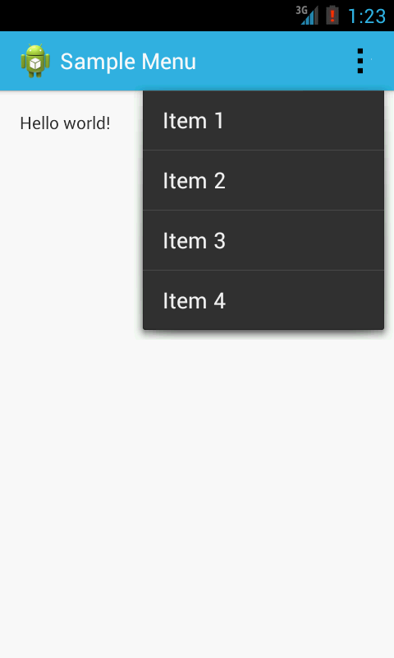
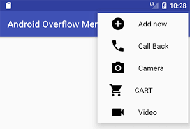
Android Options Menu
The Option Menus are the primary collection of menu items for an activity, which appears when the user touches the MENU button
• Options menu is divided into 2 types:
Icon Menu
Expanded Menu

Slide 5
Menu resource file
For all menu types, Android provides a standard XML format to define menu items.
Each menu item has various attributes associated with it.
id - This is a unique identifier for the item in the menu. You can use this to see exactly which item the user clicked
icon - If you want to show an icon associated with that menu item
title - Text that will be shown in the menu for that item
showAsAction - It controls when and how this item should appear as an action in the application bar. There are five values: always, never, ifRoom, withText, and collapseActionView

Slide 6
<?xml version="1.0" encoding="utf-8"?> <menu xmlns:android="http://schemas.android.com/apk/res/android" xmlns:app="http://schemas.android.com/apk/res-auto"> <item android:id="@+id/About" android:title="About" app:showAsAction="never"> </item> <item android:id="@+id/search" android:title="search" android:icon="@drawable/ic_action_name" app:showAsAction=“always"> </item> <item android:id="@+id/Share" android:title="Share" app:showAsAction="ifRoom"> </item> <item android:id="@+id/Contacts" android:title="Contacts" app:showAsAction="ifRoom"> </item> <item android:id="@+id/status" android:title="status" app:showAsAction="collapseActionView">
</menu>

Slide 7
Methods of Option Menus
onCreateOptionsMenu()
This method of the Activity is called when the user clicks the Menu Key of the device.
onOptionItemSelected()
This method of the activity is called when a particular Item/Option of the menu is clicked.
add()
Multiple add() methods are available.
Use the one that accepts itemId as a parameter.
setIcon() : This is used for assigning icon with the option

Slide 8
onCreateOptionsMenu()
To make an option menu, we need to Override onCreateOptionsMenu() method and inflate the menu
public boolean onCreateOptionsMenu(Menu menu) { MenuInflater menuInflater=getMenuInflater(); menuInflater.inflate(R.menu.menumain,menu); return true; }

Slide 9
onOptionsItemSelected
When the user selects an item from the options menu, the system calls your activity's onOptionsItemSelected() method.
This method passes the MenuItem selected.
You can identify the item by calling getItemId() method, which returns the unique ID for the menu item
public boolean onOptionsItemSelected(@NonNull MenuItem item) { switch (item.getItemId()) { case R.id.About: Toast.makeText(getApplicationContext(), "About clicked", Toast.LENGTH_SHORT).show(); return true; case R.id.Share: Toast.makeText(getApplicationContext(), "Share clicked", Toast.LENGTH_SHORT).show(); return true;
}

Slide 10
Contextual Menu
A context menu is a floating menu that appears when the user performs a long-click on an element.
It provides actions that affect the selected content or context frame.
It is common to use this type of menu in list or grid views, where the user’s interaction with each item can lead to a specific action.
A context menu can appear in two ways :
A floating menu
An action bar at the top of your application

Slide 11
Methods for Contextual Menu
Register the View to which the context menu should be associated by calling registerForContextMenu() and pass it the View.
you can register your all items for a context menu by passing the ListView or GridView object to registerForContextMenu() method.
Implement the onCreateContextMenu() method in your Activity.
When the registered view receives a long-click event, the system calls your onCreateContextMenu() method.
This is where you define the menu items, usually by inflating a menu resource.

Slide 12
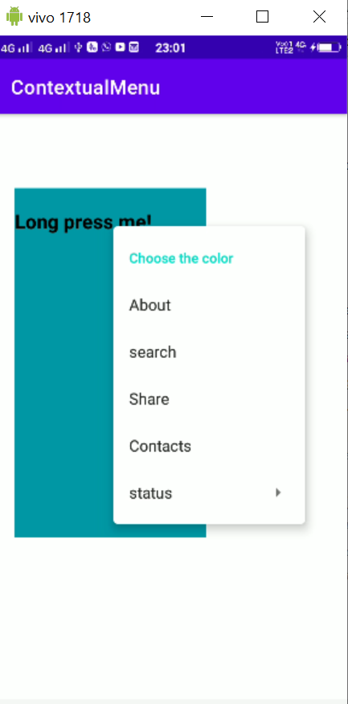
Register the view for contextMenu
textView = (TextView) findViewById(R.id.textView); // here you have to register a view for context menu // you can register any view like listview, image view, // textview, button etc registerForContextMenu(textView);
Here the textView is registered for menu.

Slide 13
onCreateContextMenu
public void onCreateContextMenu(ContextMenu menu, View v, ContextMenu.ContextMenuInfo menuInfo) { super.onCreateContextMenu(menu,v,menuInfo); menu.setHeaderTitle("Choose the color"); MenuInflater menuInflater=getMenuInflater(); menuInflater.inflate(R.menu.item,menu); }

Slide 14
onContextItemSelected
public boolean onContextItemSelected(@NonNull MenuItem item) { if(item.getItemId()==R.id.About){ linearLayout.setBackgroundColor(Color.YELLOW); }

Slide 15
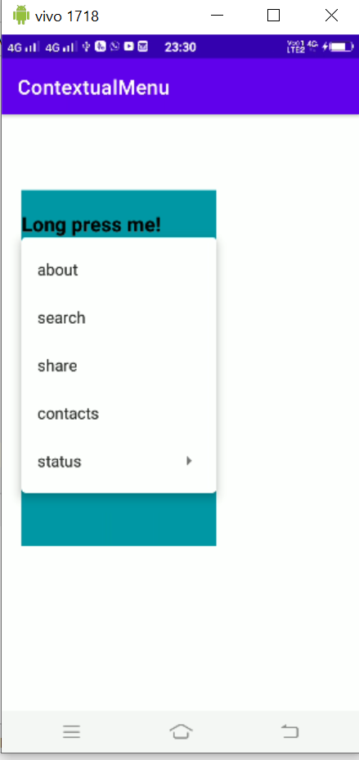
PopUp Menu
A popup menu is a type of menu that displays items in a vertical list.
MainActivity implements implements PopupMenu.OnMenuItemClickListener
register with our PopupMenu by calling setOnMenuItemclickListener().
Inflate the menu items.
When the user selects an item, the system calls the onMenuItemClick() callback in your interface.

Slide 16
>IMPLEMENT PopupMenu.OnMenuItemClickListener
public class MainActivity extends AppCompatActivity implements PopupMenu.OnMenuItemClickListener{
>Set the view onclicklistener
t1.setOnClickListener(new View.OnClickListener() { @Override public void onClick(View v) { PopupMenu popup = new PopupMenu(MainActivity.this, v); popup.setOnMenuItemClickListener((PopupMenu.OnMenuItemClickListener) MainActivity.this); popup.inflate(R.menu.item); popup.show(); } });

Slide 17
onMenuItemClick
public boolean onMenuItemClick(MenuItem item) { switch (item.getItemId()) { case R.id.About: Toast.makeText(this, "Selected Item: " +item.getItemId(), Toast.LENGTH_SHORT).show(); return true;
}

